Slide 2
Unit 8: Files and File Handling (4hrs)
File pointer, File opening modes (read, write, append)
File handling functions
Creating and operating a file in different modes

Slide 3
Contents
Introduction to Files and File-handling
Types of data files
File operations
File pointer
Library functions for IO management

Slide 4
8.1 Files and File Handling
A file is a place on the disk where a group of related data is stored.
The data file allows us to store information permanently and to access and alter that information whenever necessary.

Slide 5
Why need of File handling?
It is difficult and time consuming to handle large volume of data through terminals.
The entire data is lost when program is exit.
So, data need to be store permanently.
Thus, file handling is necessary.
Advantages of File handling:
Reusability
Large storage capacity
Saves times
Portability

Slide 6
8.2 Types of files
Text Files
created with a .txt extension using any simple text editor like notepad.
A text file stores information in the form of ASCII characters internally.
Human readable.
does not provide any security of information.
consumes large storage space.
2. Binary Files
A binary file stores information in the form of the binary number system (0’s and 1’s)
occupies less storage space. I
much easier to access.
created with a .bin extension.
not readable to humans,
the information is more secure.
best way to store information in a data file.

Slide 7
8.3 File operations
Opening a file
Naming a file
Writing data to file
Reading data from a file
Closing file

Slide 8
1. Opening a File
General form of declaring and opening a file is:
FILE *pointer;
Pointer = fopen( “file name” , “mode” );
Eg:
FILE *fp;
fp = fopen( “input.txt” , “w” );
Where ,
FILE is a special structure declared in header file stdio.h
*fp is a pointer variable to the datatype FILE
input.txt is a file name
w is write mode

Slide 9
File opening modes
S. No. | Mode | Meaning | Details
1. | w | Write | Opens new file for writing purpose If file already exists, it overwrites data. Returns NULL if file cannot be opened
2. | r | Read | Opens an existing file for reading purpose If file does not exist, it returns NULL
3. | a | Append | Opens existing file for appending (adding) data on it. If file does not exist, a new file is created implicitly.
4. | r+ | Read + write | Opens existing file for both reading and writing purpose.
5. | w+ | Write + read | Opens existing file for both reading and writing purpose.
6. | a+ | Append + read | Opens existing file for both reading and appending purpose.

Slide 10
ii) Naming a file
File can be named during creation of new file.
Syntax:
File Pointer = fopen( “file name” , “mode” );
Eg:
fp = fopen( “input.txt” , “w” );

Slide 11
iii) Reading/Writing/Appending file
The reading, writing or appending is determined by the file opening mode.
The modes are: w, r, a, w+, r+, a+

Slide 12
iv) Closing a file
All the read, write and append operation need to be done before closing the file. Finally, we must close the file which is done by fclose() function.
Syntax:
fclose( file pointer);
Eg:
fclose (fp);

Slide 13
8.4 File Pointer
a pointer which is used to handle and keep track on the files being accessed.
File pointer is declared as FILE *fp. where, ‘fp’ is a file pointer.
fopen() function is used to open a file that returns a FILE pointer.
Once file is opened, file pointer can be used to perform I/O operations on the file.
Finally, fclose() function is used to close the file.
General syntax:
FILE *filePointer1, *filePointer2, …..

Slide 14
9.5 Library functions for IO management
S.No. | Functions | Purpose
1. | EOF | Checks the end point of the file
2. | fputc() | Writes a character to the file
3. | fgetc() | Reads a character from an existing file
4. | putw() | Writes an integer value to the file
5. | getw() | Reads an integer value from an existing file
6. | fputs() | Writes a string to the file
7. | fgets() | Reads a string from an existing file
8. | fprintf() | Writes records( collection of data) to the file
9. | fscanf() | Reads records from an existing file

Slide 15
i) End of File (EOF)
The constant EOF represents an integer and it determines whether the file associated with a file pointer has reached end of file or not.
The last point of file is detected by using EOF while reading data from the file.

Slide 16
ii) Character IO
fputc()
The fputc() function writes a character to the data file which is opened with write mode.
Syntax:
fputc (variable name, file pointer);
Eg:
fputc( a, fp);
where, a is a char variable and fp is a file pointer
It writes the character stored in variable a to the file pointed by fp.
fgetc()
The fgetc() function reads a character from the file which is opened in read mode.
Syntax:
Variable = fgetc( pointer);
Eg:
a = fgetc(fp);
where, a is a char variable and fp is a file pointer

Slide 17
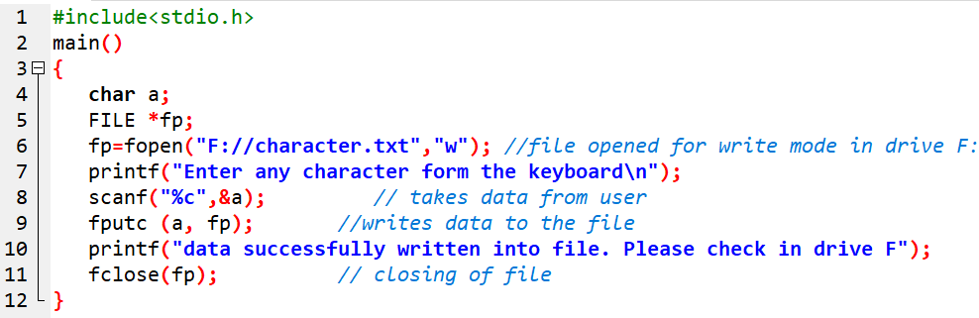

Prog 1: WAP to read data from keyboard and write it to a file “character.txt”. Again read the same data from the file and display it.
Note: If you go to drive F: , you can see a new file “character.txt” has been created. Open the file, we can see the above data written in that file.

Slide 18
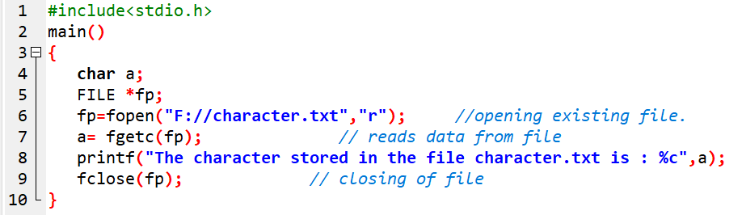
Prog 2: WAP to display the character stored in the above created file “charcter.txt”.

Slide 19
iii) Integer IO
putw()
It writes integer value to the opened file.
Syntax:
putw( variable name , filepointer);
Eg:
putw( num , fp);
where, num is an integer variable and fp is a file pointer
getw()
It reads integer value from the opened file.
Syntax:
Variable = getw ( file pointer);
Eg:
num = getw (fp);
where, num is an integer variable and fp is a file pointer

Slide 20
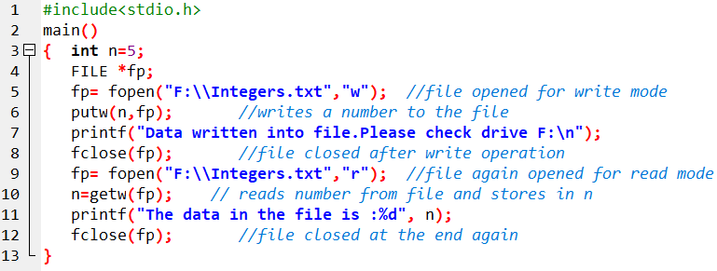

Prog 3: WAP to create a file “integer.txt” to store a number using putw functions and display the contents of that file.

Slide 21
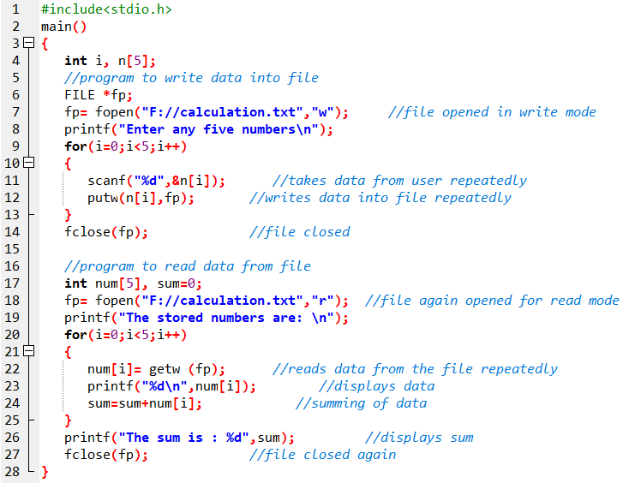
Prog 4: WAP to create a file “calculation.txt” to store any five numbers and again display the numbers and their sum using putw() and getw() functions.

Slide 22
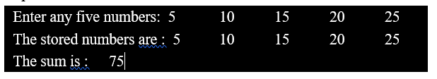

Slide 23
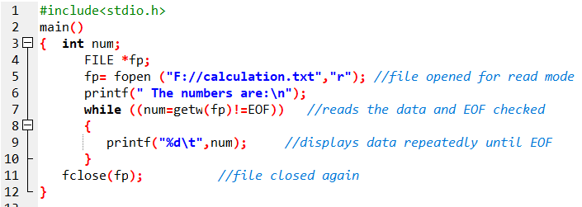

Prog 5: A file name “calculation.txt” has several numbers as data in it. Now WAP to display all those numbers.

Slide 24
iv) String IO
fputs()
It is used to write a string to a file.
Syntax:
fputs (string variable , file pointer);
Eg:
fputs (st, fp);
fputs(“hello”,fp)
where st is a string variable and fp is a file pointer, “Hello” is a string.
fgets()
It is used to read string from the opened file.
Syntax:
fgets ( string variable, value, file pointer);
Eg:
fgets (st, 100, fp);
where,
st is a string variable used for storing string data
100 denotes the number of character in a string
fp is a file pointer

Slide 25
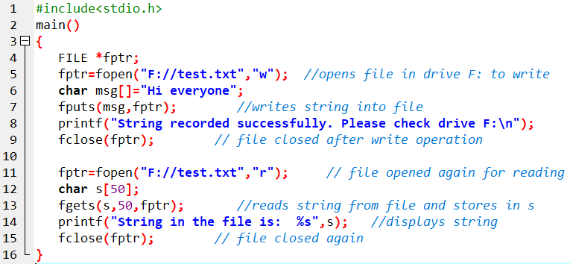

Prog 6: WAP to create a file “text.txt” to store “ Hi everyone!” to this file and also open the above file “text.txt” and display the content to the screen.

Slide 26
v) Formatted IO
fprintf()
It is used to write some integer, float , char or string data to a file.
Syntax:
fprintf ( file pointer , “control string”, variable list);
Eg:
fprintf ( fp , “ %s \t %d \t %f \n” , name, age, salary);
fscanf()
It is used to read some integer, float, char or string data from an existing file.
Syntax:
fscanf ( file pointer , “control string” , &variable list);
Eg:
fscanf ( fp , “%s \t %d \t %f \n” , &name, &age, &salary);

Slide 27
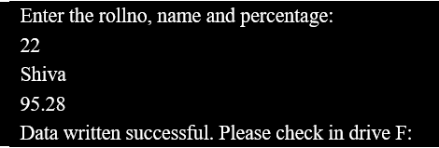
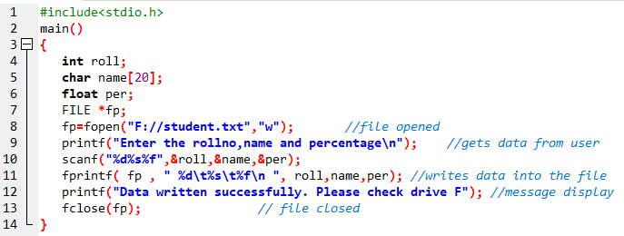
Prog 7: WAP to create a file “student.txt” to store rollno, name and percentage of a student.
Note: If you go to drive F: , you can see a new file “student.txt” has been created. Open the file, you can see the above data written in that file.

Slide 28
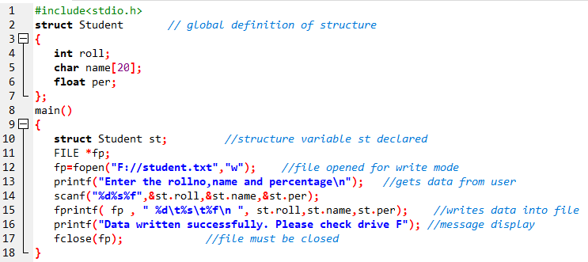
This above program can also be written using structure as:

Slide 29
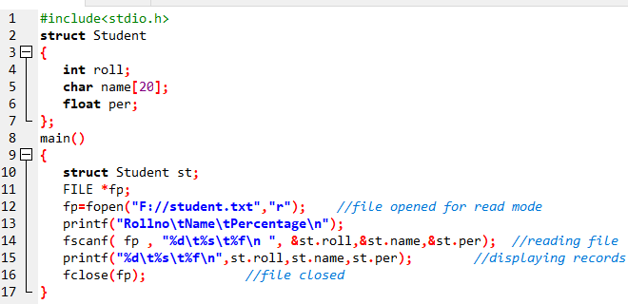

Prog 8: A file “student.txt” in drive F: consists of roll no, name and percentage of a student (referred to previously created file). Now WAP to display the record of that student.

Slide 30
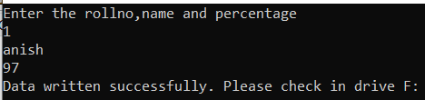
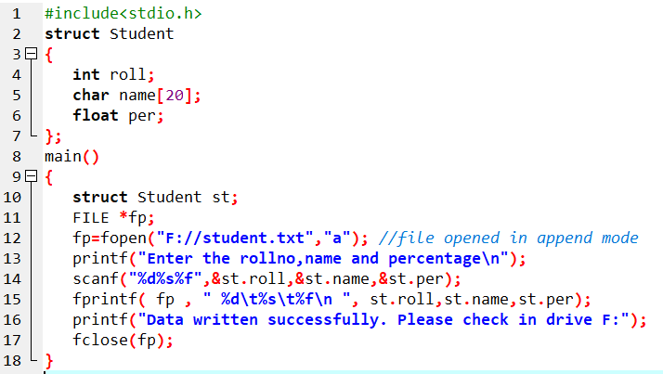
Prog 9: A file “student.txt” in drive F: consists of rollno, name and percentage of a student (referred to previously created file). Now WAP to add one more record of another student.
Note: If you check F:\student.txt, you can see one more record been added to your file.

Slide 31
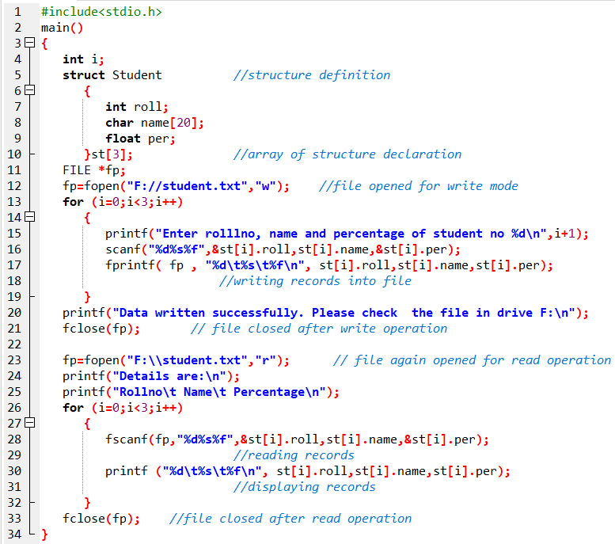
Prog 10 : Create a structure named Student having members rolll, name and per. Assume appropriate datatype and size of members, use array of structure to store rollno,nameand percentage for 3 different students in a new file “student.txt”. At the end display all the records.

Slide 32
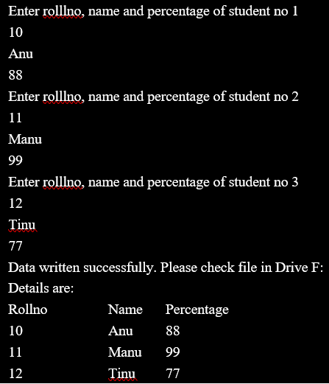

Slide 33
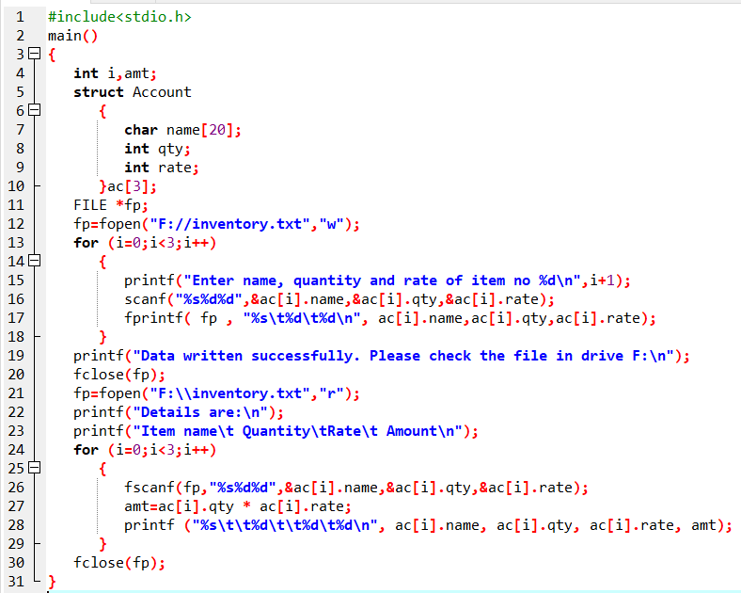
Prog 11: WAP to open a file named “inventory.txt” and store the following data and print out the details with their amount. Item Name quantity rate amount ------------------------------------------------------------------------- Apple 5 120 ---- Biscuit 2 50 ---- Chocolate 6 40 ----

Slide 34
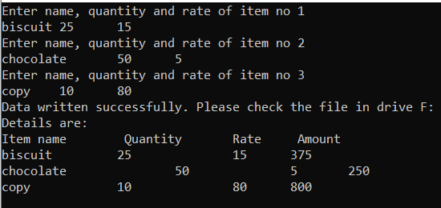

Slide 35
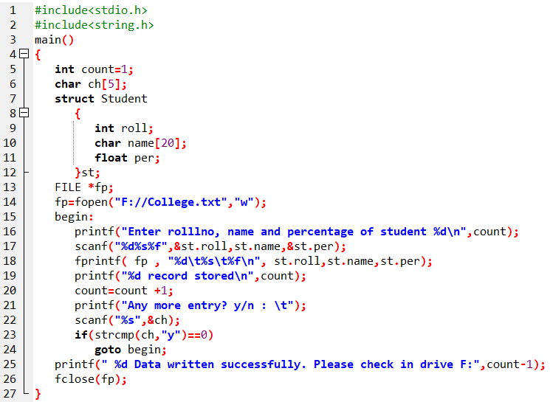
Prog 12: WAP to create a structure Student with members roll, name and per. Use this structure to read the data from user and store the record of each student according to user’s choice in a file “college.txt”. The program should prompt user to add more record. At the end the program should inform how many data has been stored.

Slide 36
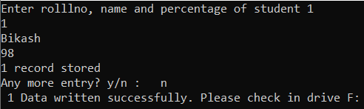

Slide 37
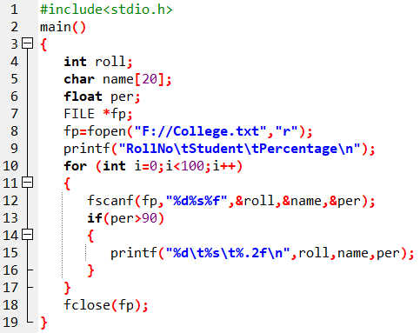
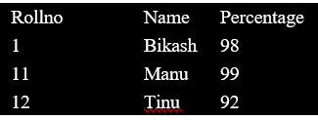
Prog 13: A file named “College.txt” has records of 100 students having the rollno, name, and percentage. WAP to print all the information of students whose percentage is more than 80.

Slide 38
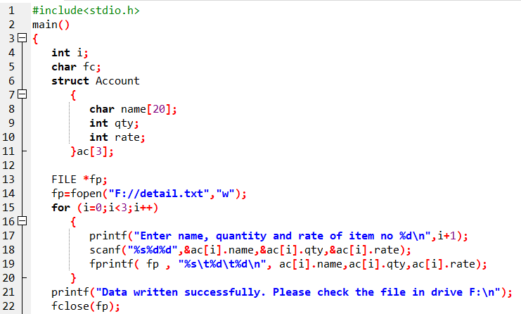
Prog 14: WAP to read the name, quantity and price of 3 items using a structure, and store the information into a file “detail.txt”. Now print the details of items that begins with “a”. Also display the items whose rates are between 10 and 20.

Slide 39
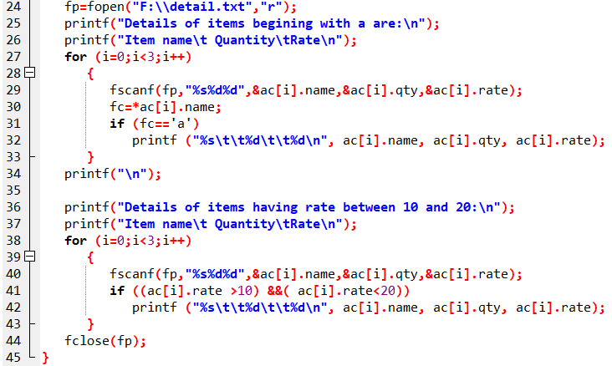

Slide 40
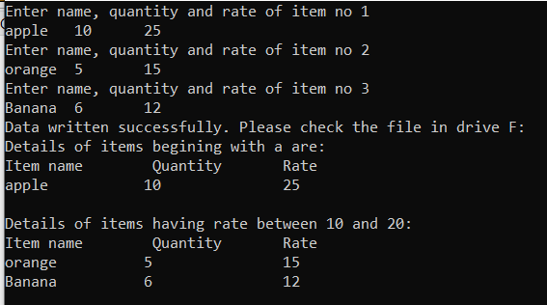

Slide 41
Assignment
WAP to create structure for the following data for a student (Rollno, name, phone no, address and semester). Now create a file “student.txt” to store this record for a student.
WAP to create structure for the following data for students (Rollno, name, phone no, address and semester). Now create a file “student.txt” to store this record for 10 students.
WAP to create structure for the following data for a student (Rollno, name, phone no, address and semester). Now create a file “student.txt” to store this record for only those student whose semester is 1.
WAP to create structure for the following data for a student (Rollno, name, phone no, address and semester). Now create a file “student.txt” to store the record for student as per user’s desire. The program should prompt user to enter more data.
A file “record.txt” contains rollno, name, address and marks of maths, science and computer of 10 students. Now WAP to add records for 5 more students in that file. At the end, display all the records of the file along with the total marks scored by each student.

Slide 42
Assignment
A file “employee.txt” consists of rollno, name, address and percentage of 10 students. Now WAP to delete those students who have failed.
A file “staff.txt” has id, name and salary and post of 10 staffs. Now WAP :
To increase the salary of all the staffs by 10% and display the updated record.
To increase the salary of only those having post “manager” by 20% and display the updated record.
A file “list.txt” consists of records of 10 staffs with the fields : id, name, address and salary. WAP to :
Display all the records of the staffs
Display only the records of those staffs having salary more than 10000
Display only the records of those staffs from pokhara.
Display all the records in ascending order of name.
Display all the information excluding ID no 5 and 10.

Slide 43
Assignment
A file “staff.txt” contains id name and salary of 10 different staffs. Now WAP to copy all these contents to a new file “employee.txt” after increasing the salary by 10%.
WAP to enter the range and store all the even numbers in a file “data.txt”. Also display those even numbers stored there.
WAP to create structure for the following data for 5 students (Rollno, name, phone-no, address and semester). Now create a file “student.txt” to store the records. Also display all the records at the end of program.
WAP to generate prime numbers in a given range and append them to a file and display the contents in the file.

Slide 44
End of Lecture 16

Slide 45
Discussion

